Slide 1
Tuples

Slide 2
A tuple is an immutable sequence of Python objects. Tuples are sequences, just like lists. The differences between tuples and lists are, the tuples cannot be changed unlike lists and tuples use parentheses, whereas lists use square brackets.
Example to create tuples
tup1 = ('physics', 'chemistry', 1997, 2000)
tup2 = (1, 2, 3, 4, 5 )
tup3 = "a", "b", "c", "d"

Slide 3
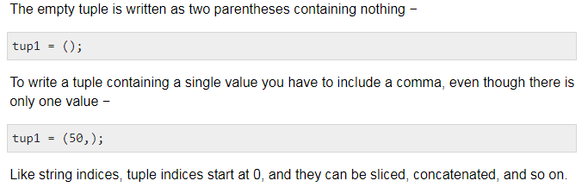

Slide 4
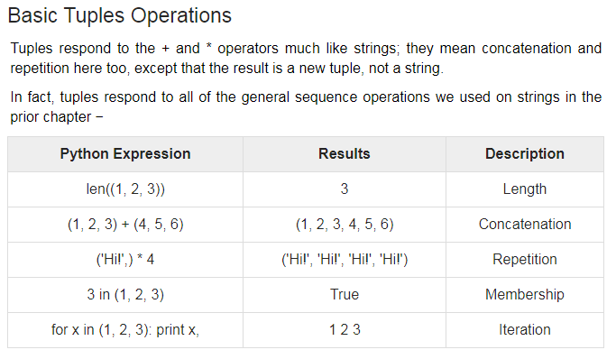

Slide 5
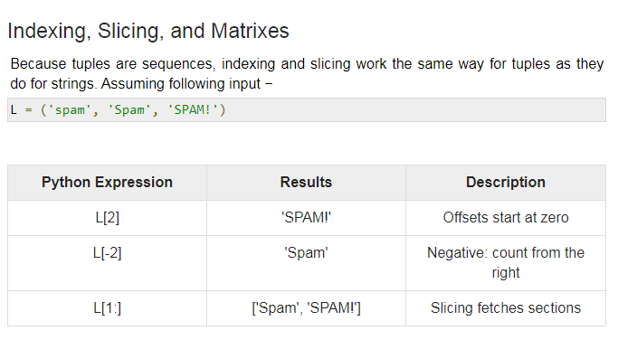

Slide 6
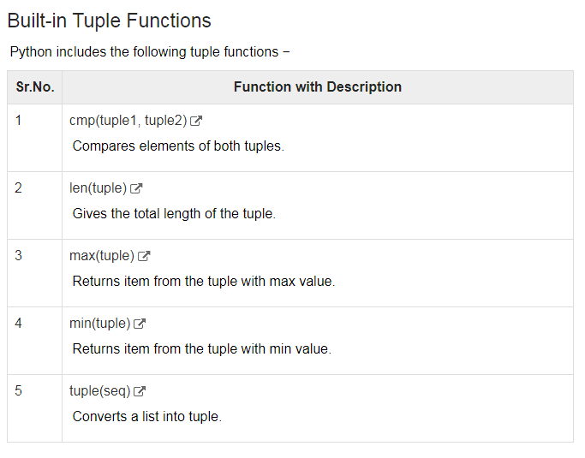

Slide 7
Thanks

